Slide 1

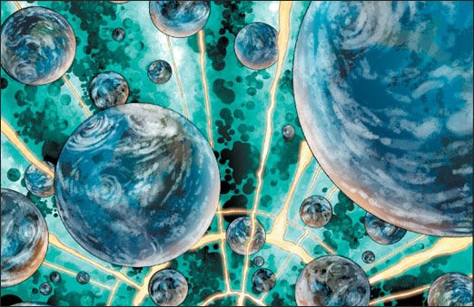
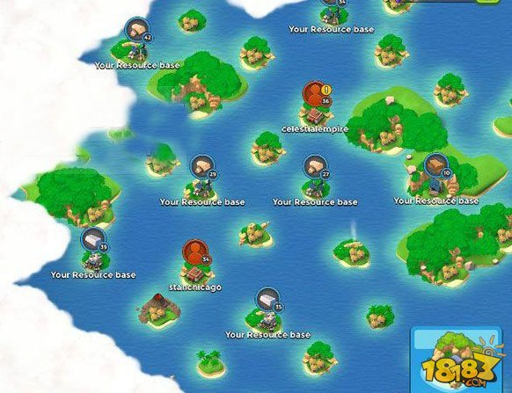
Worldmap
A map of parallel worlds
like the Boom Beach matching system
Player X
Player X
Player X

Slide 2








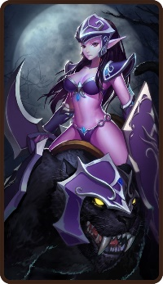


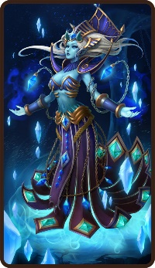



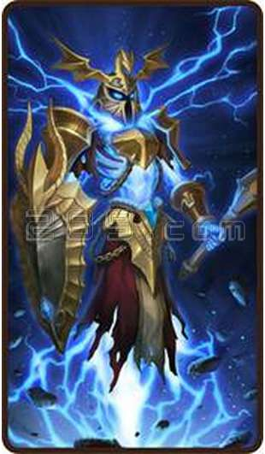
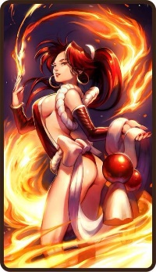


Selection Bar
Retreat
Press to unleash hero!
Siege!
Battle
PVP&PVE
District A
District B
District C

Slide 3





Card Level-Up
4 Professions
Sentinal➔Towers
Radiant ➔Troops
& Use HEROs to win Battles!

Slide 4
